Slide 1
BCSE309L Cryptography and Network Security
Course Outcomes
On completion of this course, students should be able to:
1. To know the fundamental mathematical concepts related to security.
2. To understand concept of various cryptographic techniques.

Slide 2
3. To apprehend the authentication and integrity process of data for various applications
4. To know fundamentals of Transport layer security, web security, E-Mail Security and IP Security

Slide 3
Module:1 Fundamentals of Number Theory 5 hours
Finite Fields and Number Theory: Modular arithmetic, Euclidian Algorithm, Primality Testing: Fermats and Eulers theorem, Chinese Reminder theorem, Discrete Logarithms

Slide 4
Module:2 Symmetric Encryption Algorithms
Symmetric key cryptographic techniques: Introduction to Stream cipher, Block cipher: DES, AES,IDEA, Block Cipher Operation, Random Bit Generation and RC4

Slide 5
Basic Terminology
plaintext - the original message
ciphertext - the coded message
cipher - algorithm for transforming plaintext/ciphertext
key - info used in cipher known only to sender/receiver
encipher (encrypt) - converting plaintext to ciphertext
decipher (decrypt) - recovering ciphertext from plaintext
cryptography - study of encryption principles/methods
cryptanalysis (codebreaking) - the study of principles/ methods of deciphering ciphertext without knowing key
cryptology - the field of both cryptography and cryptanalysis

Slide 6
Two kinds of Ciphers
State-of-the-art: two kinds of most popular encryption algorithms
Symmetric ciphers
  Sender and receiver share a common key
Public key ciphers
  Sender and receiver have asymmetric information of the key(s)

Slide 7
Symmetric Encryption
or conventional / private-key / single-key
was only type prior to invention of public-key in 1970’s
remains very widely used
sender and recipient share a common key
  Both parties have full information of the key
all classical encryption algorithms are common key (private-key)
  Characteristic of conventional algorithms

Slide 8
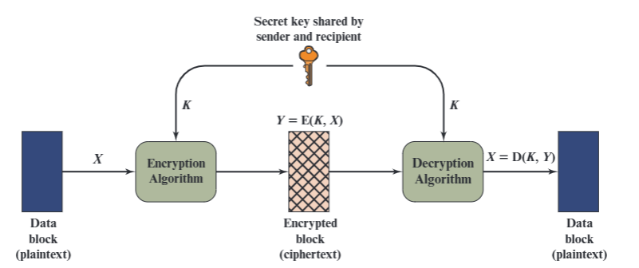
Symmetric Cipher Model

Slide 9
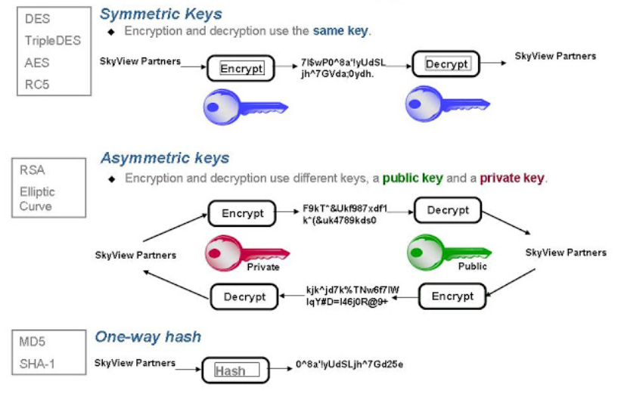
Types of Encryption Algorithms

Slide 10
Requirements
Two requirements for secure use of symmetric encryption:
  a strong encryption algorithm (keeping key secret is sufficient for security)
  a secret key known only to sender / receiver
  Y = E_{K}(X)
  X = D_{K}(Y)

Slide 11
Cryptography
can characterize by:
  type of encryption operations used
    substitution / transposition / product systems
  number of keys used
    single-key or private / two-key or public
  way in which plaintext is processed
    Block: process one block of elements a time
    Stream: continuous input, output one element a time

Slide 12
Types of Cryptanalytic Attacks
ciphertext only
  know a) algorithm b) ciphertext
known plaintext
  know some given plaintext/ciphertext pairs
chosen plaintext
  select plaintext and obtain ciphertext
chosen ciphertext
  select ciphertext and obtain plaintext
chosen text
  select either plaintext or ciphertext to en/decrypt to attack cipher

Slide 13
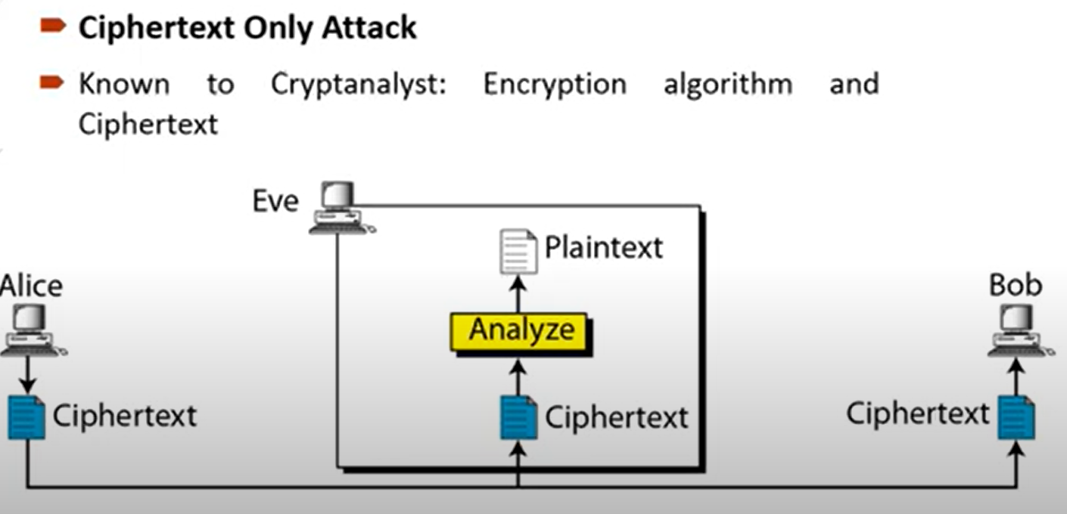

Slide 14
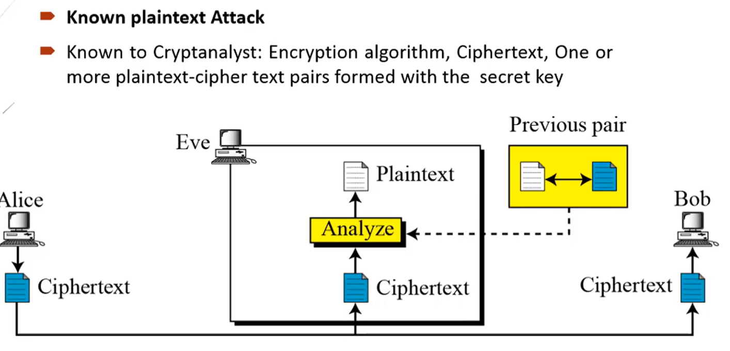

Slide 15
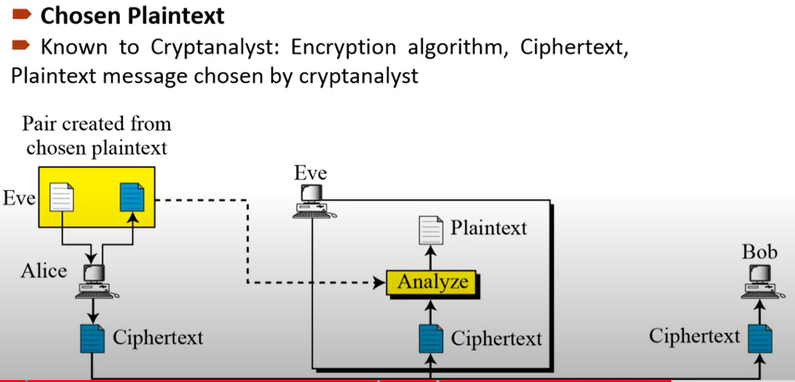

Slide 16
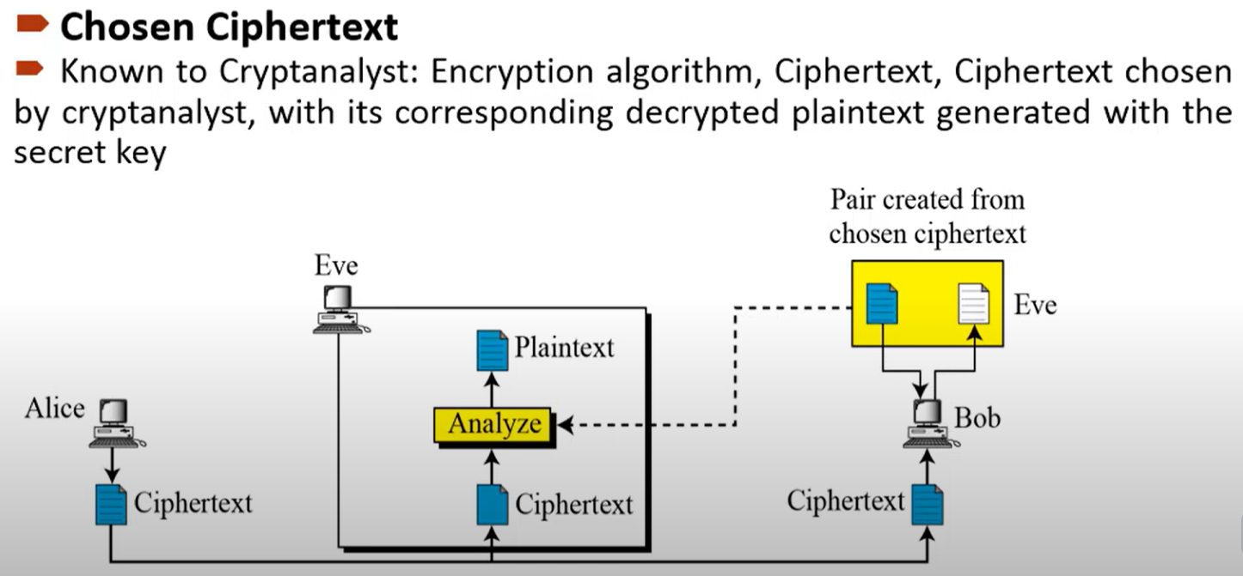

Slide 17
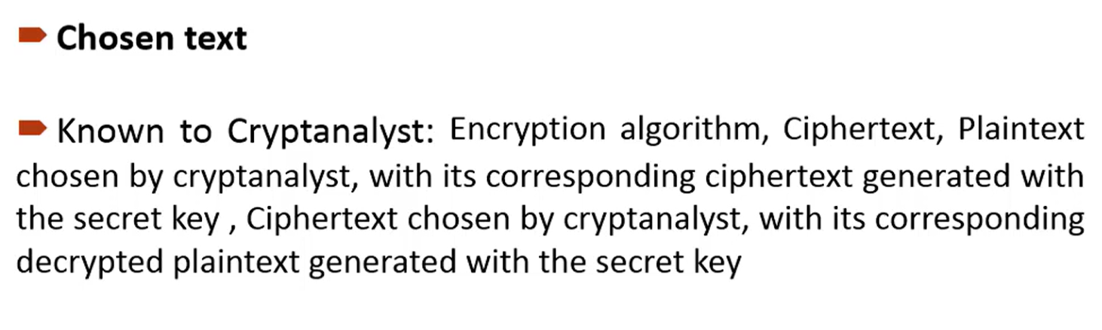

Slide 18
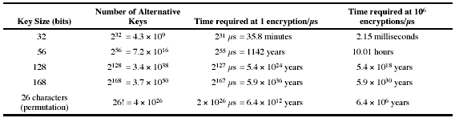
Brute Force Search
always possible to simply try every key
most basic attack, proportional to key size
assume either know / recognise plaintext

Slide 19
More Definitions
unconditional security
  no matter how much computer power is available, the cipher cannot be broken since the ciphertext provides insufficient information to uniquely determine the corresponding plaintext (non-exist in real applications)
computational security
  given limited computing resources (eg time needed for calculations is greater than age of universe), the cipher cannot be broken

Slide 20
Classical Ciphers
Examine a sampling of what might be called classical encryption techniques.
Illustrate the basic approaches to symmetric encryption and the types of cryptanalytic attacks that must be anticipated.
The two basic building blocks of all encryption techniques: substitution and transposition.

Slide 21
Classical Substitution Ciphers
where letters of plaintext are replaced by other letters or by numbers or symbols
or if plaintext is viewed as a sequence of bits, then substitution involves replacing plaintext bit patterns with ciphertext bit patterns

Slide 22
Caesar Cipher
Earliest known substitution cipher
by Julius Caesar
first attested use in military affairs
replaces each letter by a letter three places down the alphabet
example:
  meet me after the toga party
  PHHW PH DIWHU WKH WRJD SDUWB

Slide 23
Caesar Cipher
can define transformation as:
  a b c d e f g h i j k l m n o p q r s t u v w x y z
  D E F G H I J K L M N O P Q R S T U V W X Y Z A B C
mathematically give each letter a number
  a b c d e f g h i j k l m
  0 1 2 3 4 5 6 7 8 9 10 11 12
  n o p q r s t u v w x y Z
  13 14 15 16 17 18 19 20 21 22 23 24 25
then have Caesar cipher as:
  C = E(p) = (p + k) mod (26)
  p = D(C) = (C – k) mod (26)
  modulo arithmetic: 1 = 27 mod 26, 3 = 29 mod 26

Slide 24
CASE :2
Cipher Text:
Find the Key

Slide 25
Cryptanalysis of Caesar Cipher
only have 26 possible keys
  Could shift K = 0, 1, 2, …, 25 slots
could simply try each in turn
a brute force search
given ciphertext, just try all shifts of letters
do need to recognize when have plaintext
Test:break ciphertext
GCUA VQ DTGCM

Slide 26
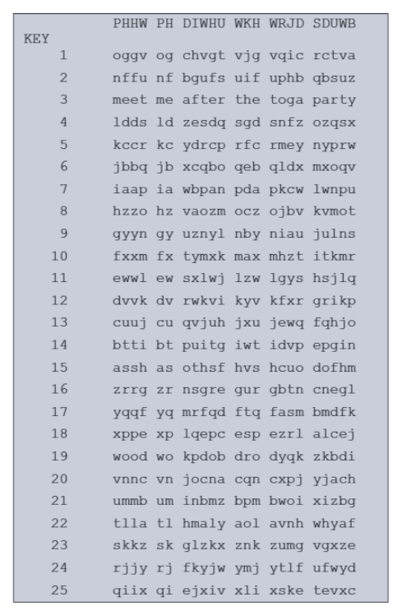

Slide 27
Monoalphabetic Cipher
rather than just shifting the alphabet
could shuffle the letters arbitrarily
each plaintext letter maps to a different random ciphertext letter
hence key is 26 letters long
  Plain: abcdefghijklmnopqrstuvwxyz
  Cipher: DKVQFIBJWPESCXHTMYAUOLRGZN
  Plaintext: ifwewishtoreplaceletters
  Ciphertext: WIRFRWAJUHYFTSDVFSFUUFYA

Slide 28
Monoalphabetic Cipher Security
now have a total of 26! = 4 x 10^26 keys
with so many keys, might think is secure
  The simplicity and strength of the monoalphabetic substitution cipher dominated for the first millenium AD.
but would be !!!WRONG!!!
  First broken by Arabic scientists in 9th century

Slide 29
Use in Cryptanalysis
key concept - monoalphabetic substitution ciphers do not change relative letter frequencies
discovered by Arabian scientists in 9th century
calculate letter frequencies for ciphertext
compare counts/plots against known values
for monoalphabetic must identify each letter
  tables of common double/triple letters help
Notes:
The simplicity and strength of the monoalphabetic substitution cipher meant it dominated cryptographic use for the first millenium AD. It was broken by Arabic scientists. The earliest known description is in Abu al-Kindi's "A Manuscript on Deciphering Cryptographic Messages", published in the 9th century but only rediscovered in 1987 in Istanbul, but other later works also attest to their knowledge of the field.

Slide 30

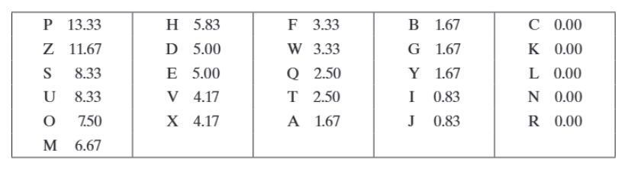
Relative Frequency of Letters in the Cipher Text in percentages

Slide 31
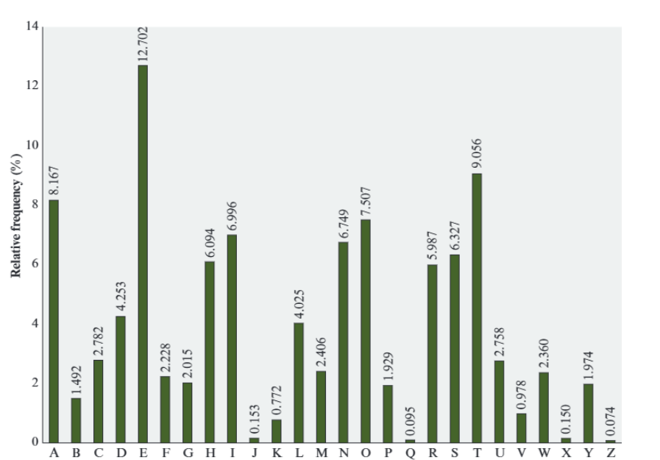
Relative Frequency of Letters in English Text

Slide 32


Slide 34
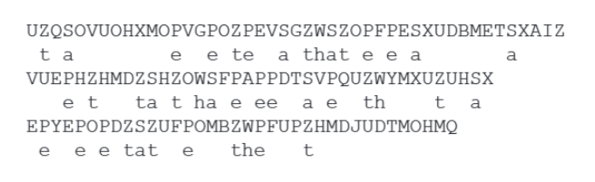
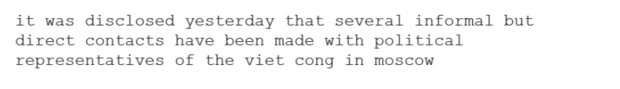

Slide 35
Playfair Cipher
not even the large number of keys in a monoalphabetic cipher provides security
one approach to improving security was to encrypt multiple letters
the Playfair Cipher is an example
invented by Charles Wheatstone in 1854, but named after his friend Baron Playfair
Notes:
Consider ways to reduce the "spikyness" of natural language text, since if just map one letter always to another, the frequency distribution is just shuffled. One approach is to encrypt more than one letter at once. Playfair cipher is an example of doing this.

Slide 36
Playfair Key Matrix
a 5X5 matrix of letters based on a keyword
fill in letters of keyword (sans duplicates)
fill rest of matrix with other letters
eg. using the keyword MONARCHY
    MONAR
    CHYBD
    EFGIK
    LPQST
    UVWXZ
Notes:
Have here the rules for filling in the 5x5 matrix, L to R, top to bottom, first with keyword after duplicate letters have been removed, and then with the remain letters, with I/J used as a single letter. This example comes from Dorothy Sayer's book "Have His Carcase", in which Lord Peter Wimsey solves this, and describes the use of a probably word attack.

Slide 37
Encrypting and Decrypting
plaintext encrypted two letters at a time:
  if a pair is a repeated letter, insert a filler like 'X', eg. "balloon" encrypts as "ba lx lo on"
  if both letters fall in the same row, replace each with letter to right (wrapping back to start from end), eg. “ar" encrypts as "RM"
  if both letters fall in the same column, replace each with the letter below it (again wrapping to top from bottom), eg. “mu" encrypts to "CM"
  otherwise each letter is replaced by the one in its row in the column of the other letter of the pair, eg. “hs" encrypts to "BP", and “ea" to "IM" or "JM" (as desired)
Notes:
Note the various rules, and how you wrap from right side back to left, or from bottom back to top. Decrypting of course works exactly in reverse. Can see this by working the example pairs shown, backwards.

Slide 38
Security of the Playfair Cipher
security much improved over monoalphabetic
since have 26 x 26 = 676 digrams
would need a 676-entry frequency table to analyse (verses 26 for a monoalphabetic)
and correspondingly more ciphertext
was widely used for many years (eg. US & British military in WW1)
it can be broken, given a few hundred letters
since still has much of plaintext structure

Slide 39
Transposition Ciphers
now consider classical transposition or permutation ciphers
these hide the message by rearranging the letter order
without altering the actual letters used
can recognise these since have the same frequency distribution as the original text
Notes:
All the techniques examined so far involve the substitution of a ciphertext symbol for a plaintext symbol. A very different kind of mapping is achieved by performing some sort of permutation on the plaintext letters. This technique is referred to as a transposition cipher, and form the second basic building block of ciphers. The core idea is to rearrange the order of basic units (letters/bytes/bits) without altering their actual values.

Slide 40
Rail Fence cipher
write message letters out diagonally over a number of rows
use a “W” pattern (not column-major)
then read off cipher row by row
eg. write message out as:
  m e m a t r h t g p r y
  e t e f e t e o a a t
giving ciphertext
  MEMATRHTGPRYETEFETEOAAT
Notes:
The simplest such cipher is the rail fence technique, in which the plaintext is written down as a sequence of diagonals and then read off as a sequence of rows.
The example message is: "meet me after the toga party" with a rail fence of depth 2.
This sort of thing would be trivial to cryptanalyze.

Slide 41
Row Transposition Ciphers
is a more complex transposition
write letters of message out in rows over a specified number of columns
then reorder the columns according to some key before reading off the rows
  Key: 4312567
  Column Out 4 3 1 2 5 6 7
  Plaintext: a t t a c k p
  o s t p o n e
  d u n t i l t
  w o a m x y z
  Ciphertext: TTNAAPTMTSUOAODWCOIXKNLYPETZ
Notes:
A more complex transposition cipher is to write the message in a rectangle, row by row, and read the message off shuffling the order of the columns in each row. The order of the columns then becomes the key to the algorithm. In the example shown, the key is 4312567, that is use column 4 first, then column3, then 1 etc (as shown in the Column Out row).
A pure transposition cipher is easily recognized because it has the same letter frequencies as the original plaintext. For the type of columnar transposition just shown, cryptanalysis is fairly straightforward and involves laying out the ciphertext in a matrix and playing around with column positions. Digram and trigram frequency tables can be useful.

